Slide 1
Power Automate - Power User Module 1 – Introduction & Overview
Sheldon Ledbetter Principle Customer Engineer

Slide 2

Objective
In this module you will get an introduction to Power Automate and an overview of the components

Slide 3







Business Application Platform
A single, unified extensibility platform
Power BI
PowerApps
Microsoft Flow
Power BI
Business analytics
Power Apps
Application development
Power Automate
Process automation
Power Virtual Agents
Intelligent virtual agents
Common Data Service
Connectors + gateways
Data connectors
AI Builder
Dataverse

Slide 4




Microsoft Power Automate
Helps business-power-users work smarter by automating workflows across apps and services. Workflows in Power Automate are called “Flows”
Get notifications
Copy files
Collect data
Automate approvals

Slide 5
Flow process
Trigger
One trigger to start flow:
A trigger is a condition or check that will kick off a flow
Scheduled
PowerApps button click or control select event
File/E-mail/Contact created
HTTP Triggered/Webhook
Actions (1…n)
Any number of actions after trigger:
If the trigger condition is successfully met, any number of subsequent actions can take place
For example “…look up the current user’s profile and then email that user’s manager”

Slide 6
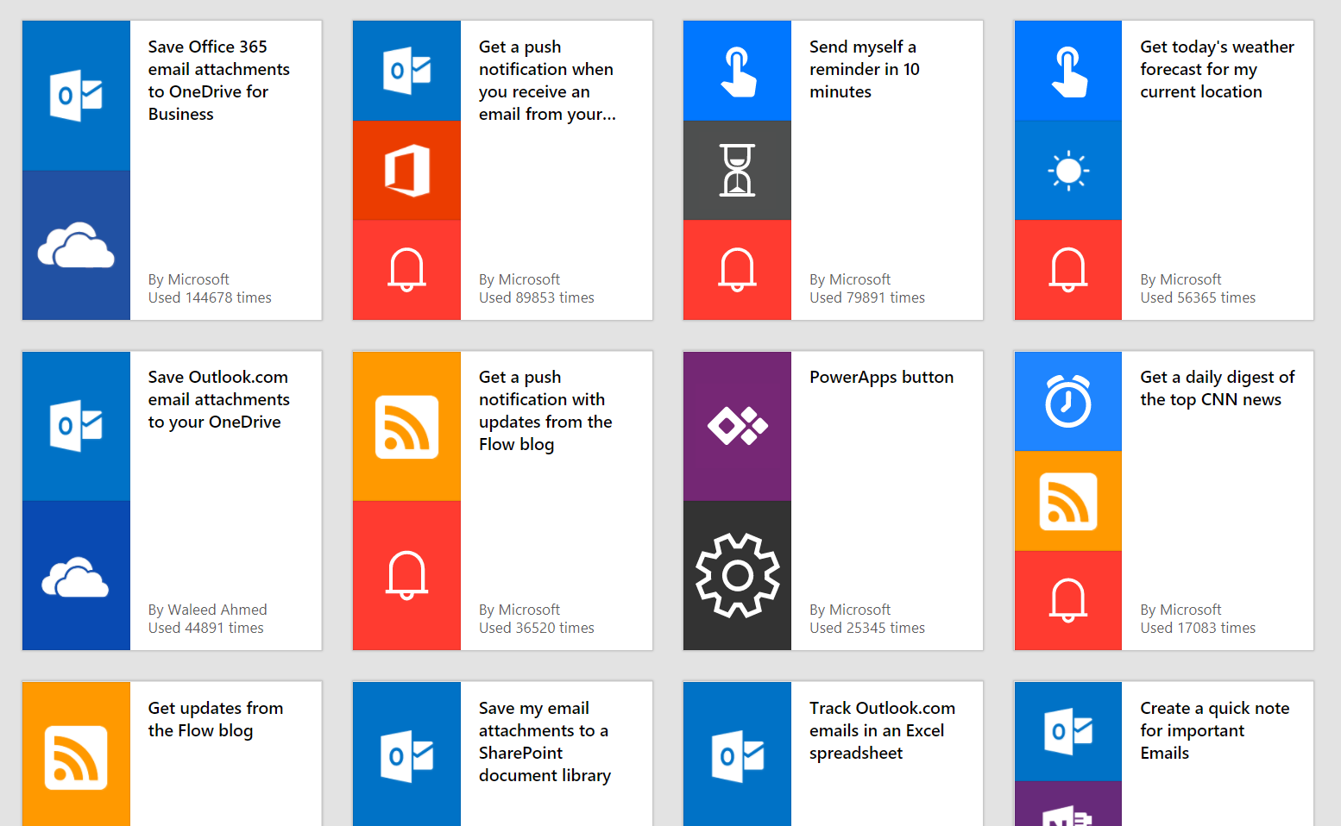
Get started quickly with a growing library of templates - 700+
Notes:
Flip to corp env and show some differences

Slide 7
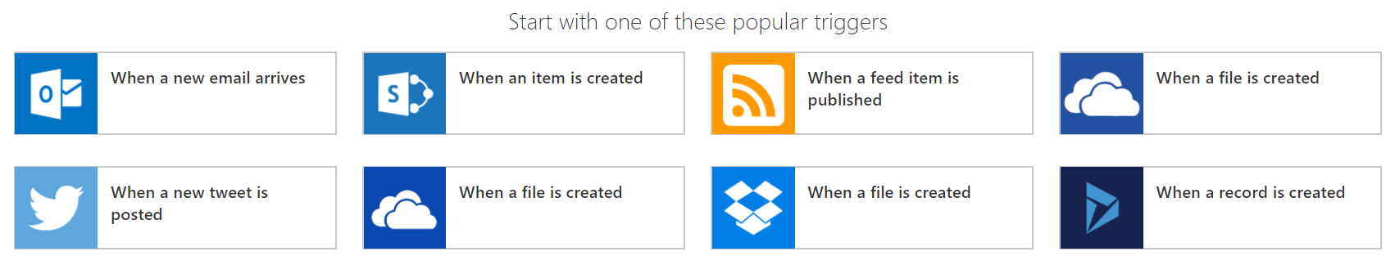
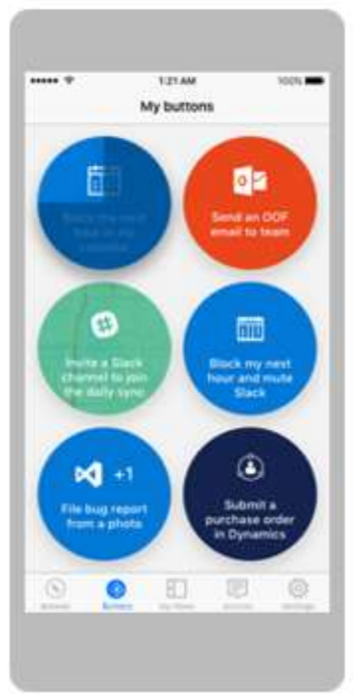
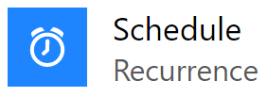
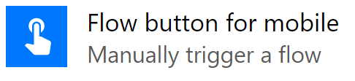
Start from a blank
Can also be a Schedule or a Button

Slide 8
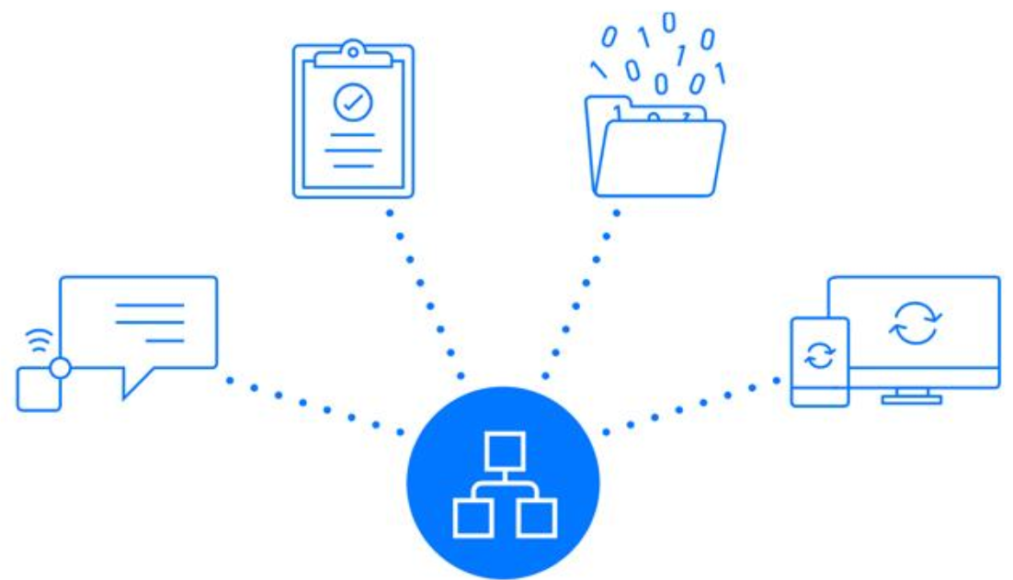
Connectors
Connectors can be used to connect
in and out from the flow

Slide 9
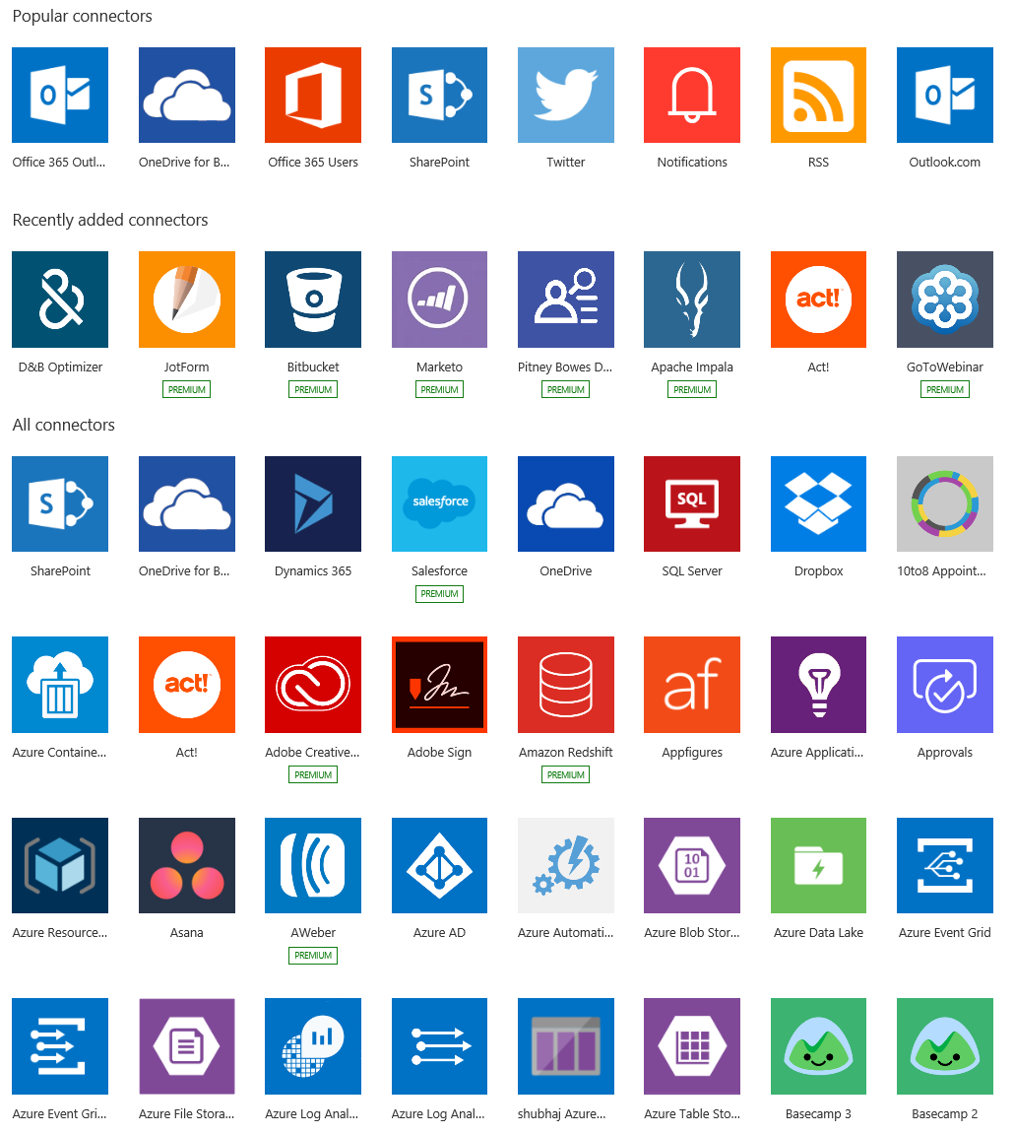
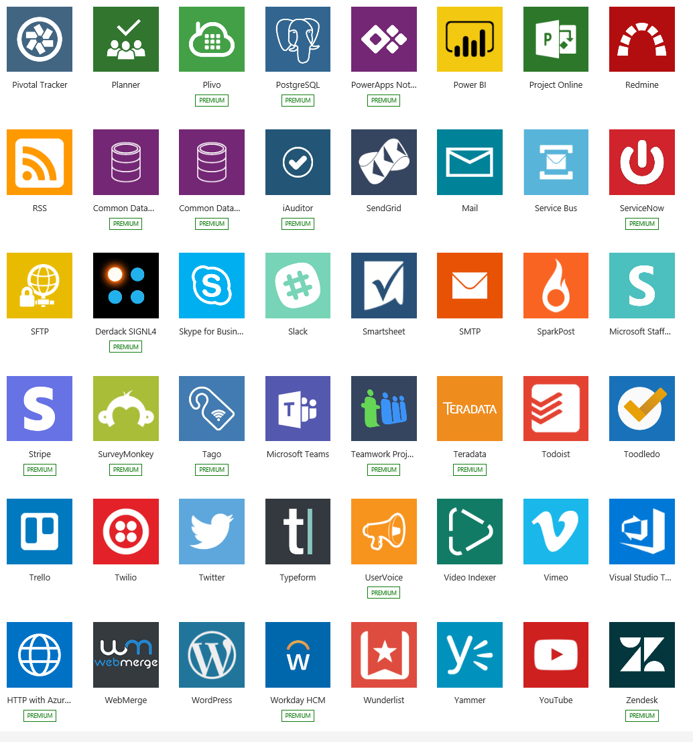
Connectors Gallery 1000+

Slide 10
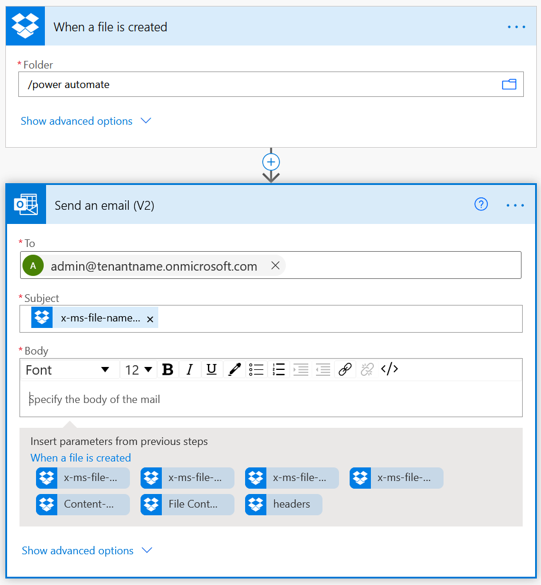
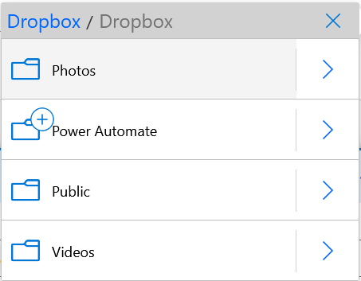
Build your own flows in an easy-to-use Visual Designer
Sending an Exchange email when a new file is added in Dropbox
Authenticate to your Dropbox account.
Select folder to monitor
Choose to include properties from previous step (Dropbox file) to improve relevance
Authenticate to your O365 account. Build email Subject and Body
Specify Send To email address and additional properties (optional): From, CC, BCC and Importance

Slide 11
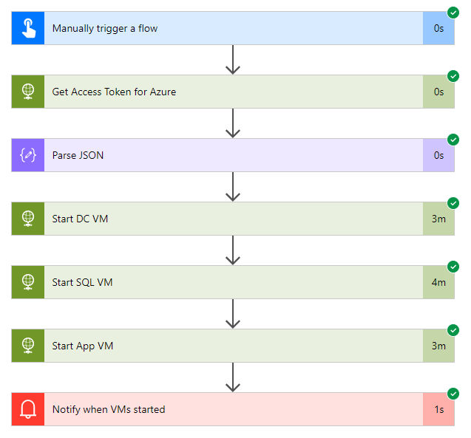
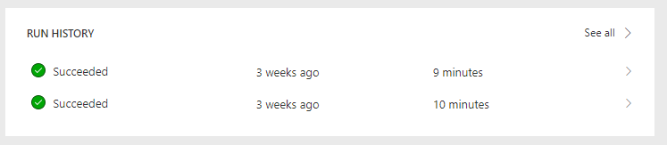
Track history of flow runs
Run history stored for 30 days
See flow run success or failure with ability
to dive into more details as needed
Notes:
Documentation:
https://docs.microsoft.com/en-us/flow/modern-approvals

Slide 12
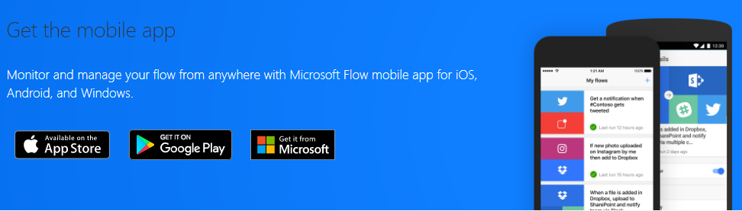
Power Automate – Mobile App
Install the Power Automate Mobile App – go to the app store, install and sign in with your account
Notes:
Demo zphone MS Power User env

